Slide 1
REINFORCEMENT TEST
PYTHON
LAPTOP DATASET
KISHORE VASUDEVAN
09/05/2025
DATA ANALYTICS & DATA SCIENCE
FEB 25’

Slide 2

INTRODUCTION
This project analyses a laptop dataset containing detailed specifications such as company, type, screen size, RAM, storage, GPU, OS, and price. The primary objective is to clean and analyse this dataset to extract meaningful insights and understand key drivers of laptop pricing.
DATASET
OBJECTIVE
To analyze and understand the key specifications and factors that influence laptop pricing by cleaning, transforming, and exploring a real-world dataset.

Slide 3


DATA UNDERSTANDING
Company
The manufacturer or brand of the laptop.
TypeName
The type or category of the laptop (e.g., gaming, ultrabook)
Inches
The size of the laptop screen in inches.
ScreenResolution
The resolution and display technology of the laptop screen.
CPU
The processor (CPU) model of the laptop.
RAM
The amount of Random Access Memory (RAM) in the laptop.
Memory
The storage capacity (hard drive or SSD) of the laptop.
GPU
The graphics processor (GPU) model of the laptop.
Operating System
Price
The operating system installed on the laptop.
The price of the laptop in the local currency.
Weight
The weight of the laptop in kilograms.

Slide 4
DATA CLEANING
Explored dataset to understand structure and quality issues
Removed duplicate and fully null rows
Dropped irrelevant columns like Unnamed: 0
Standardized categorical values (e.g., “Netbook” → “Notebook”)
Cleaned and converted data types for numeric operations
HANDLING MISSSING VALUES
Analyzed missing data count and percentage per column
Filled missing TypeName values with "unknown"
Replaced null or invalid Inches and Weight with 0
Dropped rows with all null values
Imputation (e.g., filling with default values like 0 or “unknown”)
Row deletion (only if entire row had nulls)

Slide 5
OUTLIERS HANDLING
Detected extreme values in Inches and Weight
Applied logical boundaries (e.g., screen sizes and weights outside normal laptop ranges)
Replaced outliers with column mean (e.g.,Screen sizes outside 13–17.3 inches Weights outside 1–4.5 kg)
A price outlier of ₹324,954 was retained, as it reflected a high-end laptop with premium specs like a dedicated GPU.
HANDLING INVALID VALUES
"?" in Inches and Weight columns

Slide 6
DESCRIPTIVE ANALYSIS
Mean Screen Size: ~14.91 inches; range: 13.3 – 17 inches
Mean Weight: ~2.05 kg; range: 1.0 – 4.4 kg
Average Price: ₹59,955; range: ₹9,270 – ₹3,24,954
Median Price: ₹52,161 (more accurate central tendency due to skewed pricing)
RAM: Average 8.47 GB, with a max of 64 GB indicating high-performance laptops
INSIGHT
Most laptops fall in the mid-range segment based on price and specs
Price distribution is positively skewed due to high-end outliers
RAM and weight show moderate variation, aligning with consumer-grade laptops
Price outlier (₹3,24,954) retained due to justified high-end configuration

Slide 7

INDEPENDENT TTEST
· An Independent Ttest on GPU Type vs Price reveals a statistically significant price difference between Integrated and Dedicated GPUs, leading to rejection of the null hypothesis.

Slide 8
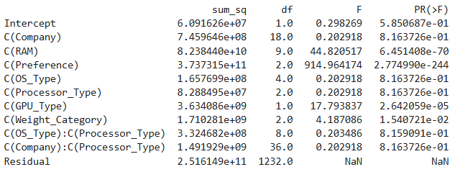
TWO-WAY ANOVA TEST
RAM and User Preference have a strong, statistically significant impact on laptop price.
GPU_Type and Weight Category also show significant effects, indicating performance and portability influence pricing.
Company, OS_Type, and Processor_Type have no significant effect on price when other specs are considered.
Interaction effects (e.g., OS × Processor, Company × Processor) are not significant, suggesting these combinations do not jointly influence pricing

Slide 9
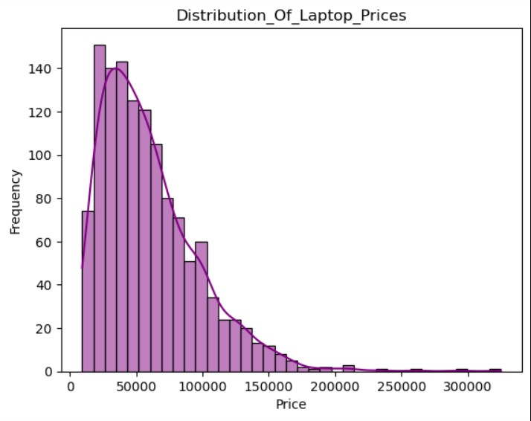
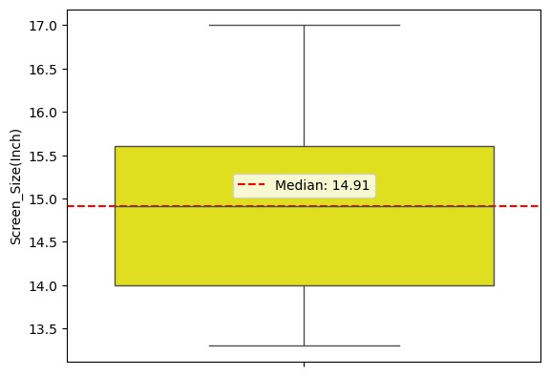
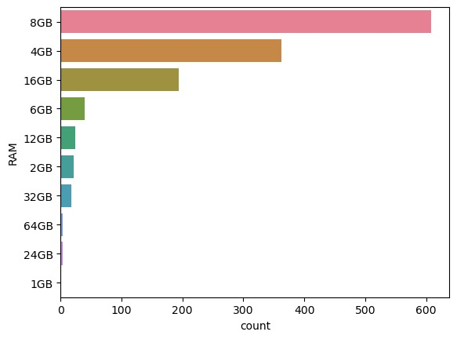
UNIVARIANT

Slide 10
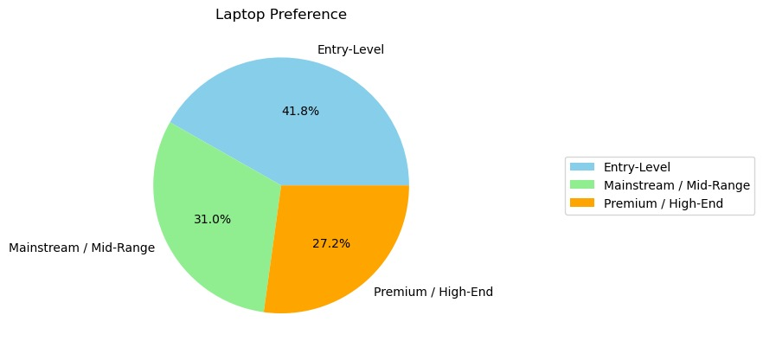
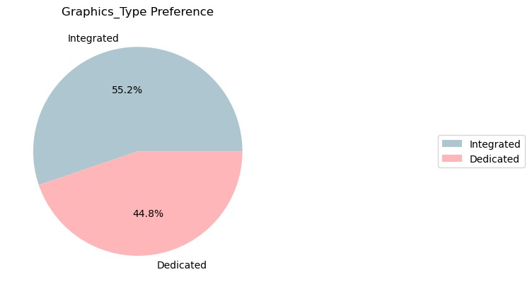
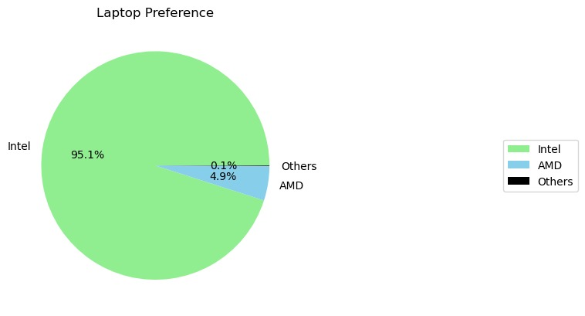
UNIVARIANT

Slide 11
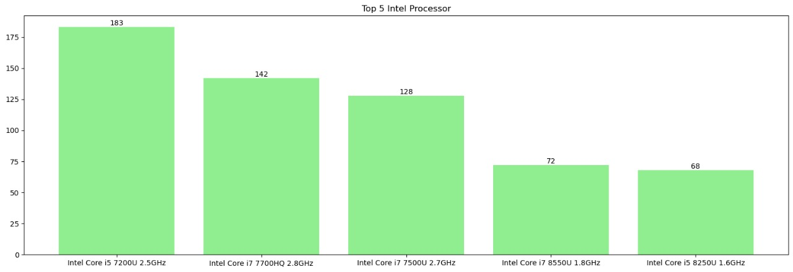
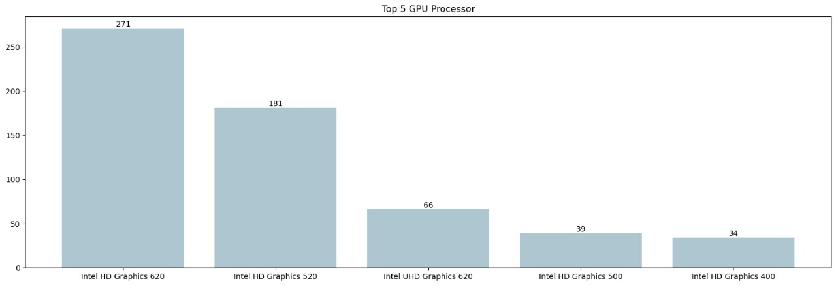
UNIVARIANT

Slide 12
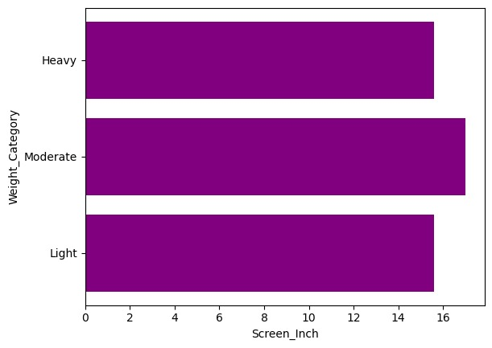
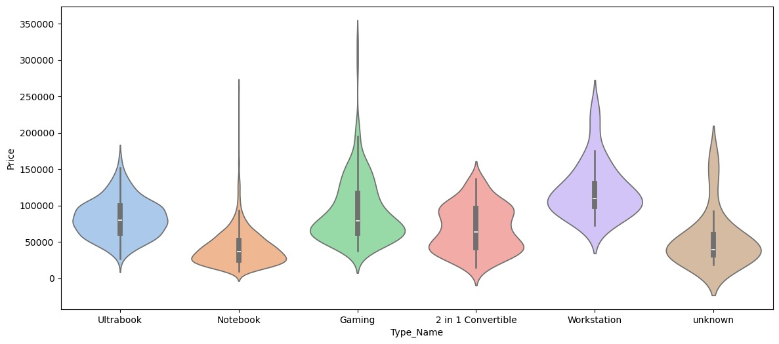
BIVARIANT

Slide 13
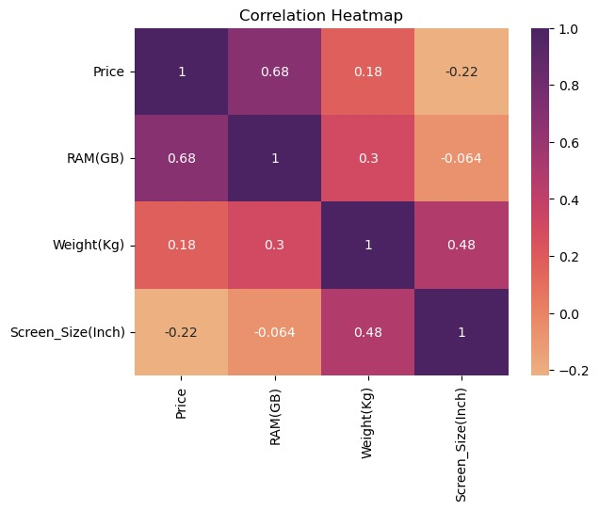
MULTIVARIANT

Slide 14
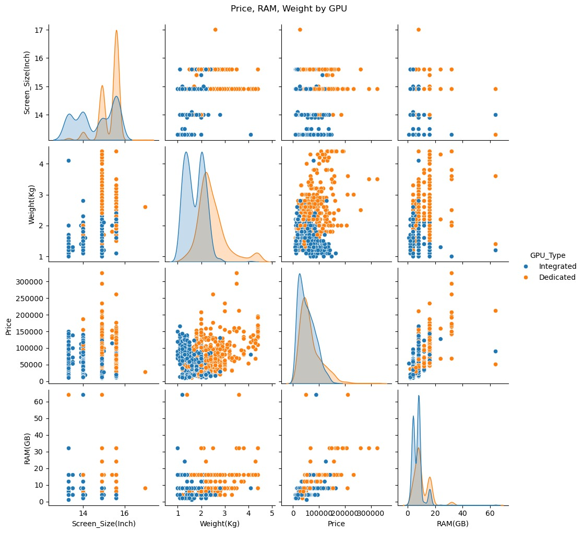

Slide 15
INSIGHTS
Price is positively skewed; most laptops priced around ₹52,000.
99% of prices are below ₹1,67,785.
₹3,24,954 laptop not treated as an outlier due to high-end specs (e.g., dedicated GPU).
Median screen size is 14.91 inches with no major outliers.
8GB RAM is most common (608 units), followed by 4GB (362 units).
High RAM, dedicated GPU, and powerful processors lead to higher prices.
Most preferred weight category is ≤ 3.5 kg.
Strong correlation between Price and RAM.
Moderate correlation between Price and Weight.
Screen Size shows negligible correlation with PriceLenovo (290) and Dell (287) are top-selling brands.
Lenovo dominates entry-level segment.
Notebook laptops are most popular (717 units), Lenovo contributes 174 of these.
Entry-level laptops make up 41.8% of market, mid-range 31%, high-end 27.2%.
Intel has 95.1% processor market share.
Intel Core i5 U GHz is the most used processor (183 units).
Integrated GPUs are more common; Intel HD Graphics 620 found in 271 units.

Slide 16
Thank
You.

